Slide 1
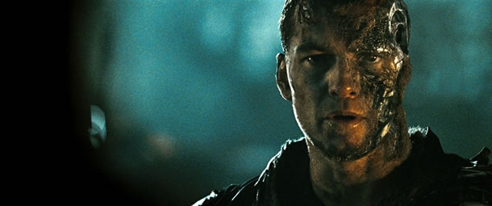
Ethics
What is truly right? For humans? For robots?
Asimov’s Three Sets of Robotic Laws (Runaround)
Replacing humans with robots
IBM’s “Watson” - Jeopardy’s Q&A Repository
Capable of so much, but to what extent?
“We have hundreds of examples today of Narrow AI… and the narrowness is gradually getting less narrow”
Kurzweil’s “Merging with the Machines”
Sam Worthington as Marcus Wright,
Terminator Salvation
Notes:
Refer to Asimov’s Three Sets of Robotic Laws, Runaround = Short story introduced by Asimov about a space trip to Mercury involving the use of
http://www.rci.rutgers.edu/~cfs/472_html/Intro/NYT_Intro/History/Runaround.html
A robot may not injure a human being, or, through inaction, allow a human being to come to harm.
-Human’s can’t be harmed
A robot must obey orders given it by human beings except where such orders would conflict with the First Law.
-Obey Human’s as long as Human’s safe
A robot must protect its own existence as long as such protection does not conflict with the First or Second Law. (I, Robot,6)
-Protect self as long as obeying humans or human’s safe
2) IBM’s Watson
Central repository of information, interprets and provides solutions
-Restricted solely towards its sole objective, possibly experts may be replaced for Watson
3) AI Becoming decentralized: More specific AI allows us to weed out what would be considered “Right or Wrong” in our society

